Slide 1

Exploration of BlackRock – ETF's

Slide 2
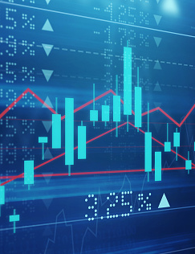
Introduction – Our goal & how we wanted to accomplish it
Our Goal
How we aimed to accomplish it

Slide 3

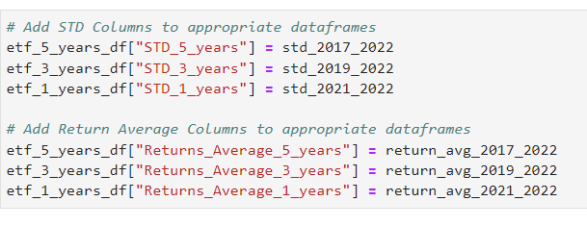
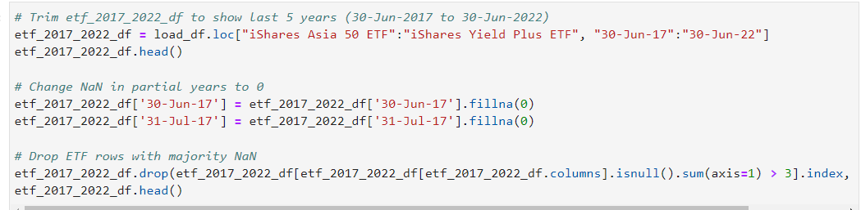
Preprocessing of data

Slide 4
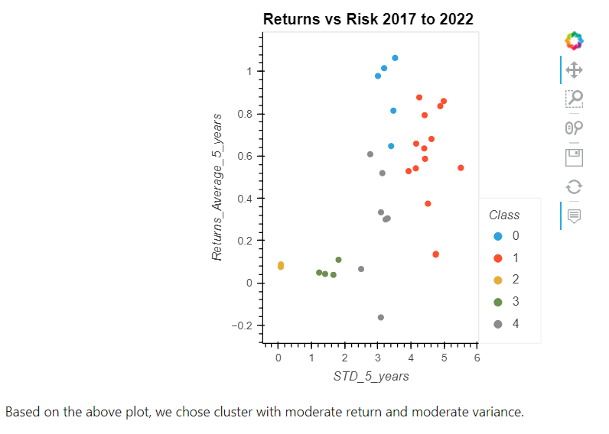
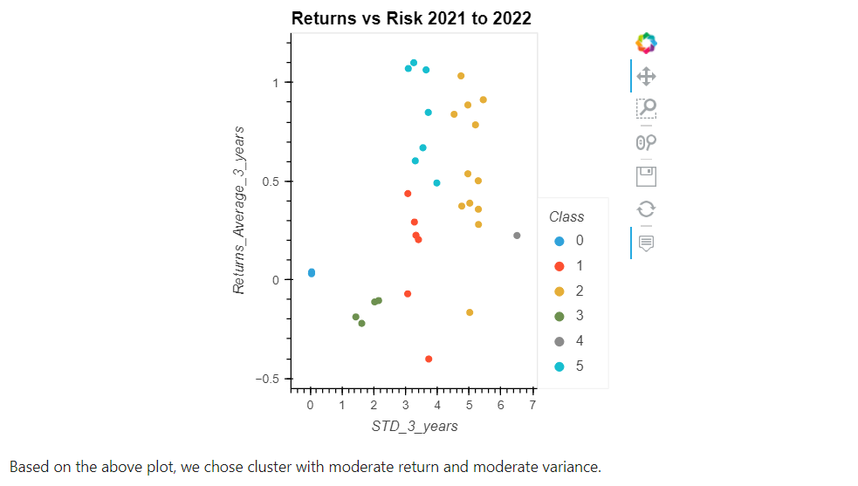
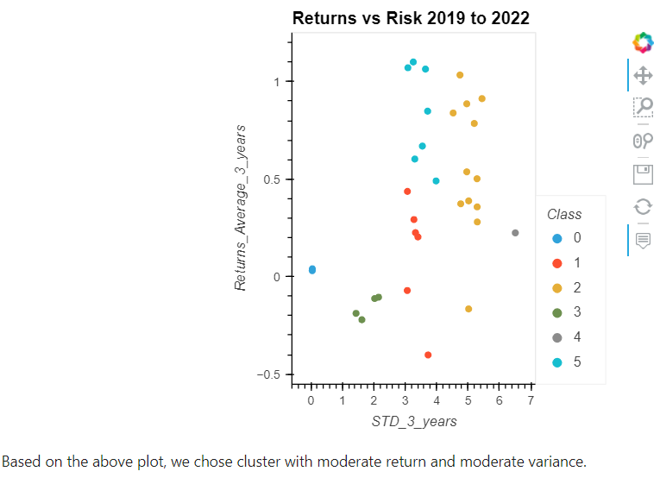
Processing data - unsupervised machine

Slide 5
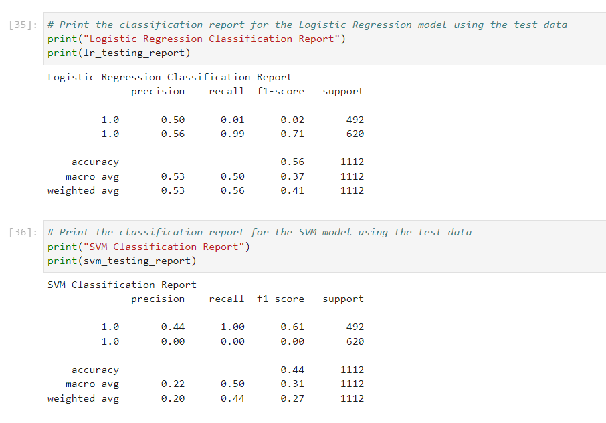
SVM vs Logistic regression

Slide 6
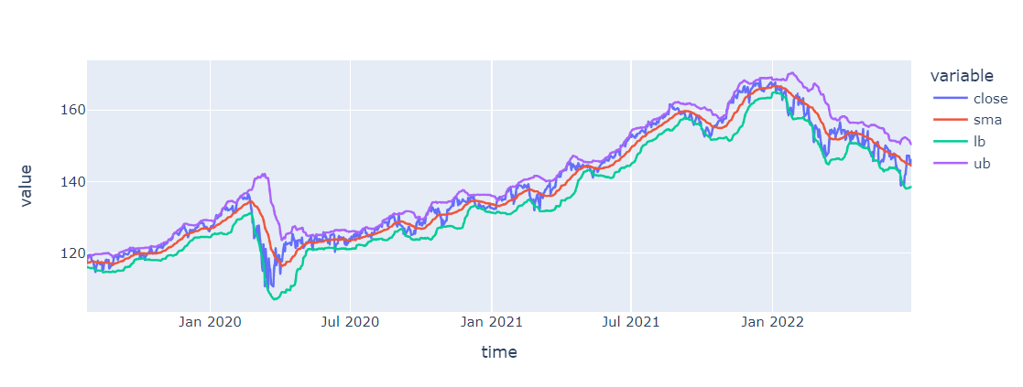
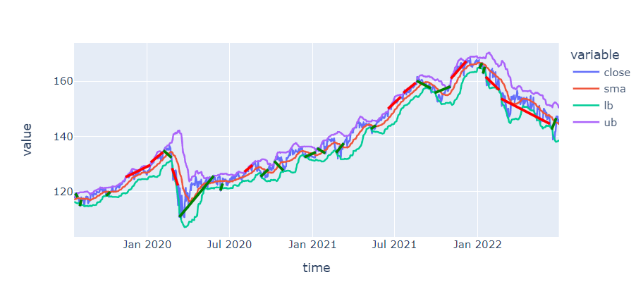
Bolinger Line

Slide 7

Any questions ?

